Slide 1
How to: N424 and N523
While working in networking labs always be aware of trip hazards and trailing cables

Slide 2
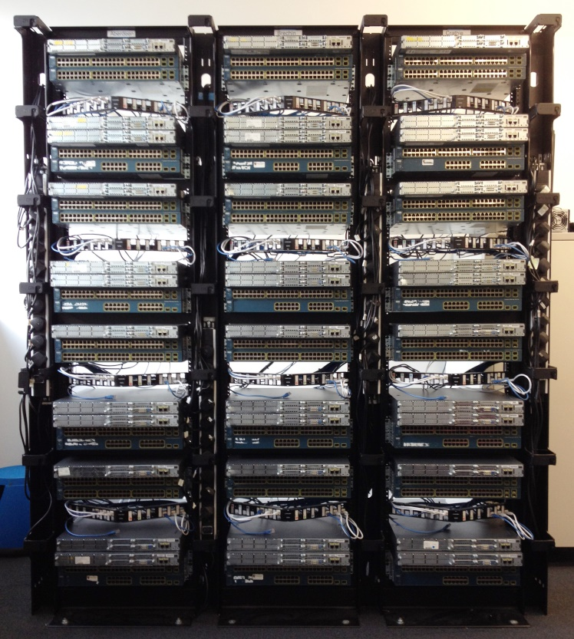
N424 (CISCO Lab)
24 Seats
1 x 2811 Router WIC-2T
2 x 3650 Layer 3 Switch
OR
12 Seats
3 x 2811 Router WIC-2T
3 x 3650 Layer 3 Switch

Slide 3
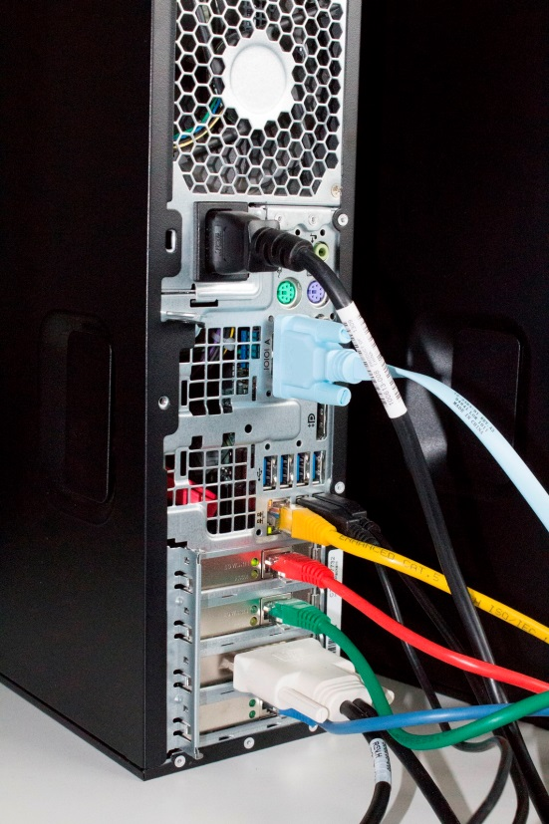
N424 (CISCO Lab)
Windows PC (Physical Host)
4 Network Cards (Red, Blue, Green, Yellow)
3 Windows Virtual PCs (Red, Blue, Green)
1 Kali Linux Virtual PC (Red)
1 Serial (console) cable

Slide 4
N424 (CISCO Lab)
Windows PC (Physical Host)
Each colour of Virtual Machine is connected to the matched colour of network card.
The serial (console) cable is ONLY connected to the physical host.
The on-board (yellow) network card is connected to the RGU campus network.
Passwords are typically cisco01

Slide 5
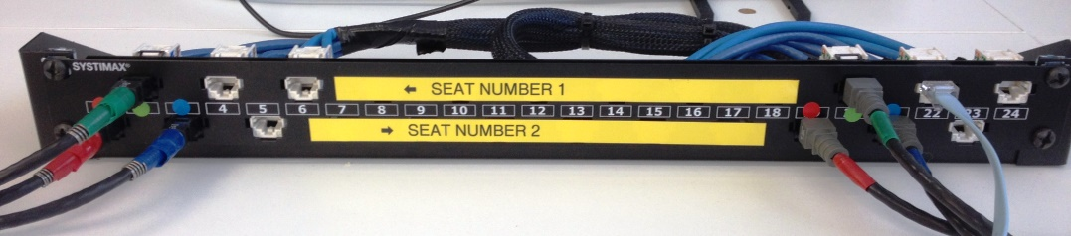
N424 (CISCO Lab)
Horizontal Cabling – Each PC:
3 Ethernet cables (R/G/B)
3 console cables (white)
Running to numbered patch panels in Racks

Slide 6
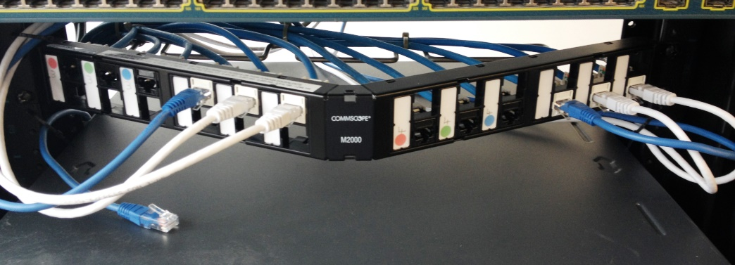
N424 (CISCO Lab)
Console Connections
3 Console connections are available for each PC
They can be repatched as needed to devices
Console Connections
White cables connect to switches
Blue cables connect to routers

Slide 7
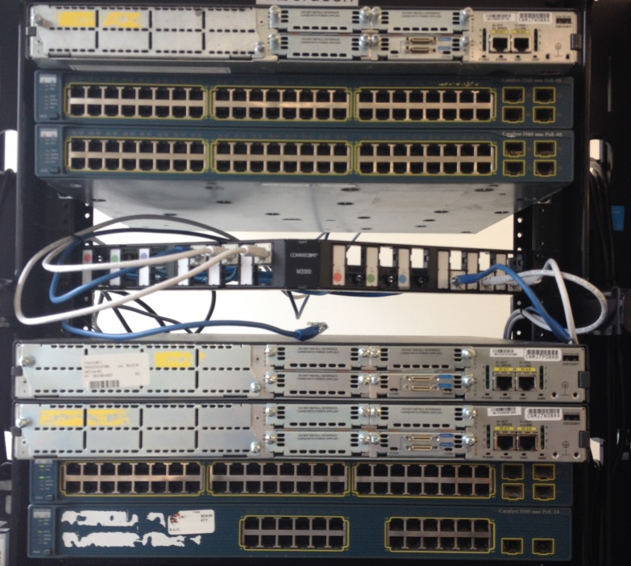
N424 (CISCO Lab)
Equipment Pods
Devices are grouped into ‘Pods’ within the equipment rack
Each ‘Pod’ has 2 switches and 1 router.
OR two adjacent ‘pods’ can be combined for half the number of students

Slide 8
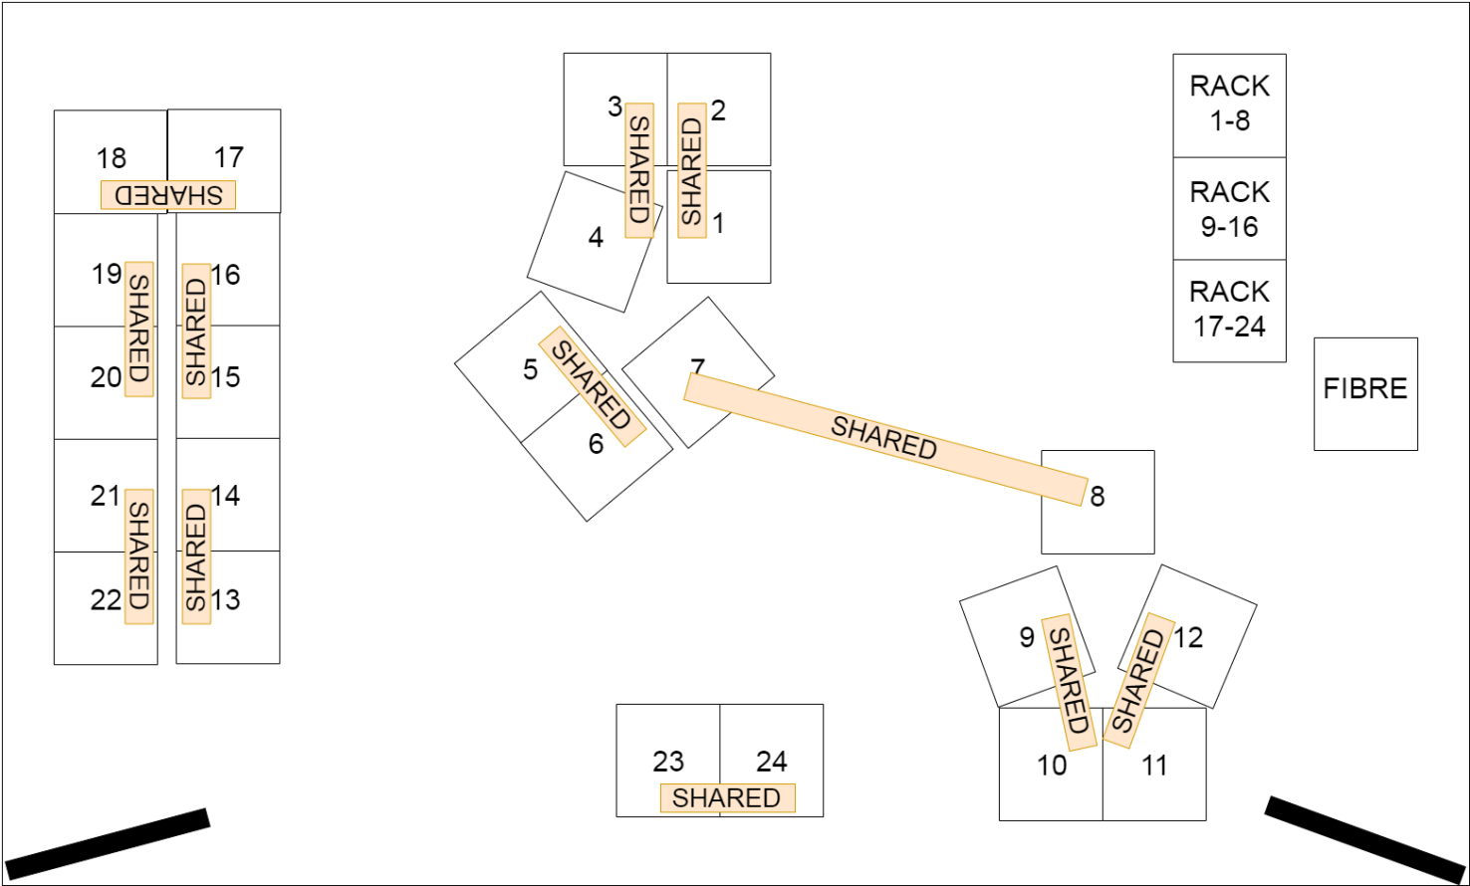
N424 (CISCO Lab)

Slide 9
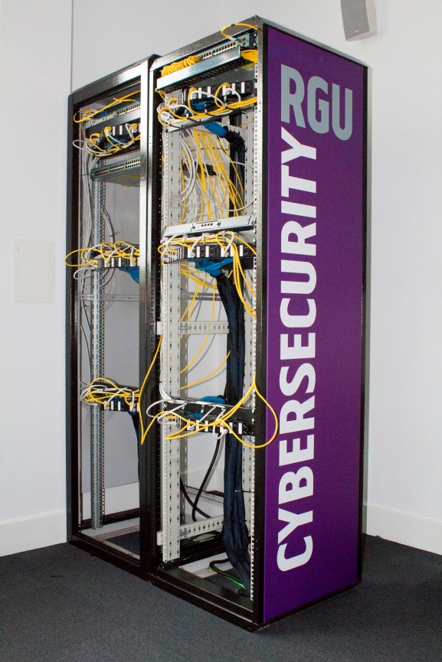
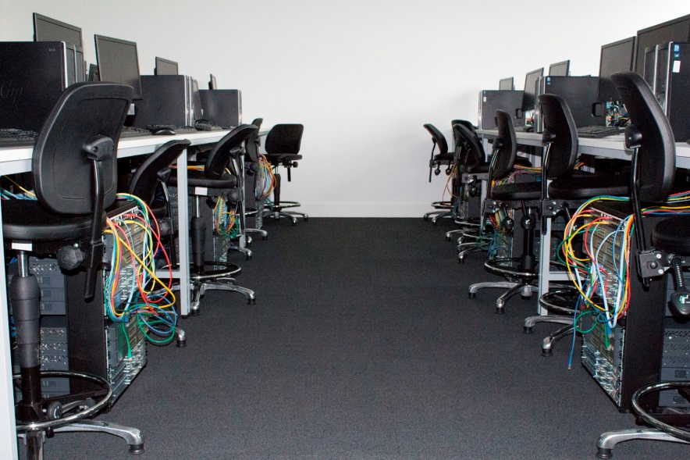
N523(Cybersecurity Lab)

Slide 10
N523(Cybersecurity Lab)
Windows PC (Physical Host)
4 Network Cards (Red, Blue, Green, Yellow)
3 Windows Virtual PCs (Red, Blue, Green)
Other Security VMs (Red)
1 Serial (console) cable

Slide 11
N523(Cybersecurity Lab)
Windows PC (Physical Host)
Each colour of Virtual Machine is connected to the matched colour of network card.
The serial (console) cable is ONLY connected to the physical host.
The on-board (yellow) network card is connected to the RGU campus network.
Passwords are typically cisco01

Slide 12
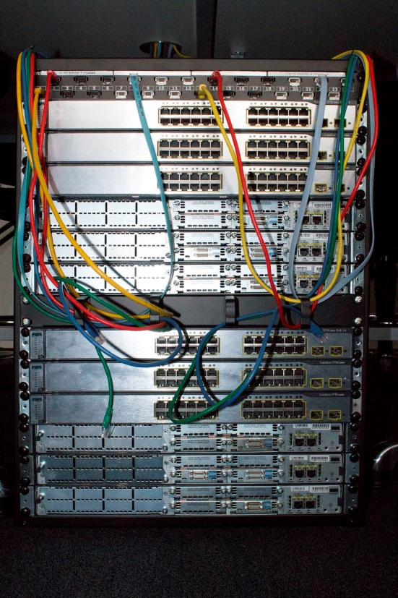
N523(Cybersecurity Lab)
Equipment Pods
Each underdesk rack has 2 pods of 3 switches and 3 routers.
The left seat uses the top set, the right seat uses the bottom set.
A cable management bar separates the two pods of equipment

Slide 13

N523(Cybersecurity Lab)
Horizontal Cabling
Each colour of horizontal cabling from the PCs network cards run out at the top of the equipment rack shared by two seats. Left and right.
The black patch ports run under the floor to the main equipment racks.
Port 1 (always yellow), connects to the RGU network.
Port 2 (always red), connects to the cybersecurity network.

Slide 14
N523(Cybersecurity Lab)
Horizontal Cabling
The white patch ports are connected to the console ports of the switches and routers.
Top 3 for switches
Bottom 3 for routers
The left seat uses white ports 7 - 12
Right seat uses white ports 19 - 24

Slide 15
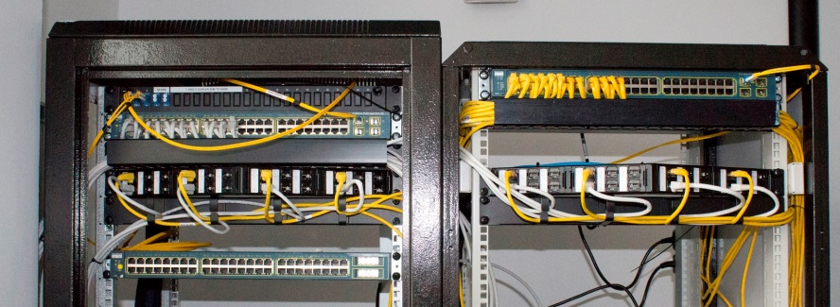
N523(Cybersecurity Lab)
Equipment Racks
The black patch ports on the under desk pods run under the floor to the individual patch panels in the main racks.
Port 1 (yellow) connects to the RGU network
Port 2 (grey) connects to the cybersecurity network
Ports 3 – 6 can be patched as required to other equipment

Slide 16
ALWAYS
Remove any patch cables you have used.
Remove any passwords you have configured.
Beware of trip hazards.
Leave the lab as tidy as you would like to find it
Power off equipment at the end of the day.

